Slide 1
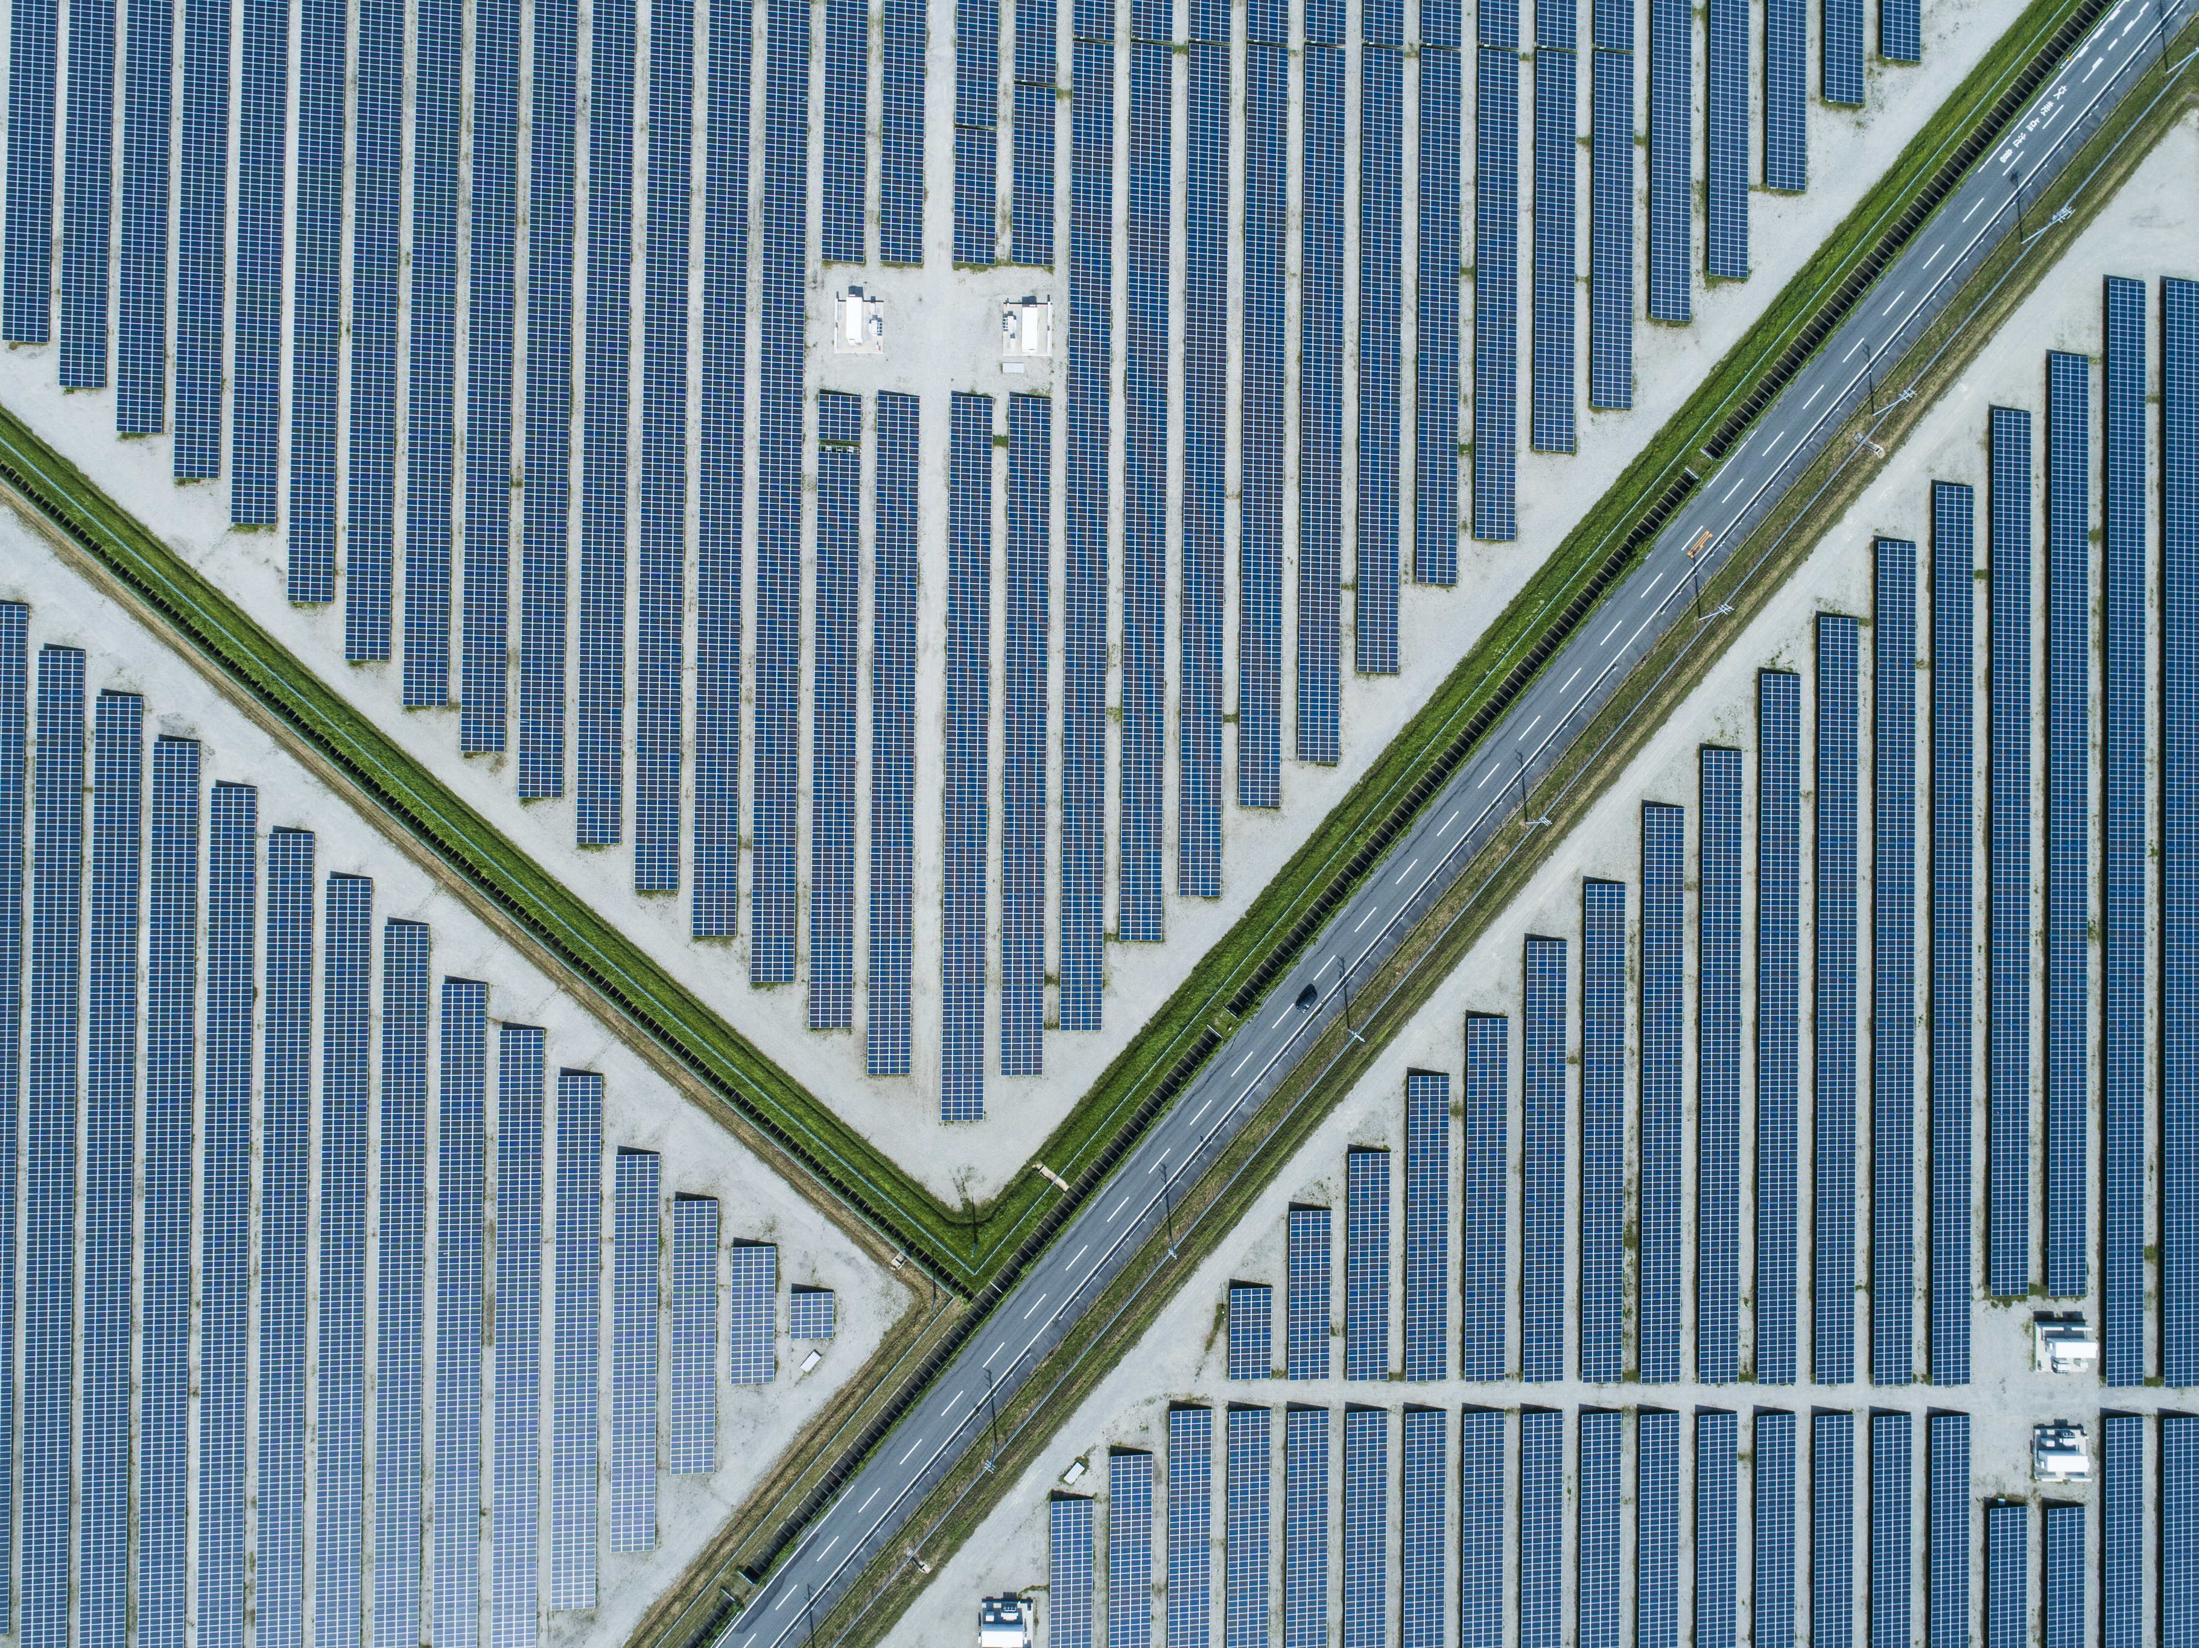
A first look at ACCESS NWP solar irradiance forecasts
Exploring applications for the energy industry
11th June 2021
Chris Bridge
Research to Operations
Bureau of Meteorology

Slide 2
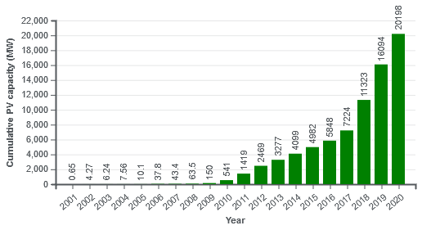
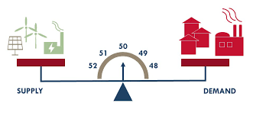
Motivation
Penetration of solar electricity is increasing in Australia
The electricity network needs to balance supply and demand.
Intermittent nature of solar brings supply-side unpredictability.
Forecasting solar irradiance can help estimate supply and maintain balance in the network.
Solar irradiance from NWP has a role - how do ACCESS forecasts perform?
31 March 2021
2.77 million PV installations
21.4GW capacity
(Aust PV Inst.)
Image: Wikipedia, data: Australian PV Institute
Image: AEMO

Slide 3
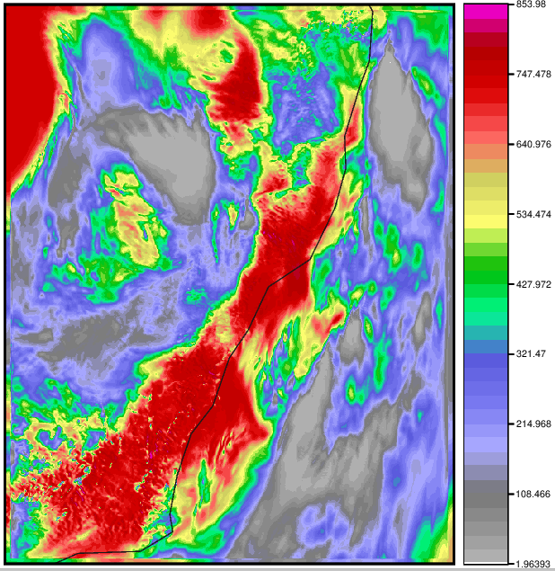
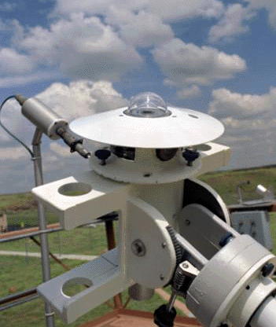
ACCESS solar irradiance forecasts
Global horizontal irradiance (GHI):
ACCESS-G3 (12km)
ACCESS-C3 (1.5km)
ACCESS-CE3 (12 members, 2.2km)
Hourly forecast steps
"Day ahead" forecasts from 12UTC model runs
Forecasts compared to in situ pyranometer observations.
ACCESS-C3 (NSW) 12 forecast step valid 20200211 00UTC
Pyranometer

Slide 4
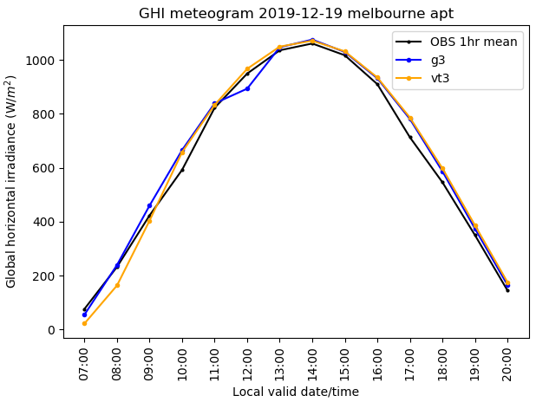
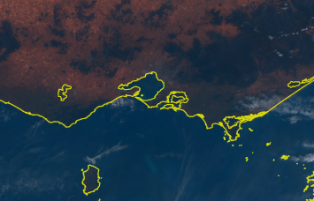
Clear skies over Melbourne Airport
Model | GHI Bias | GHI RMSE
G3 | 19 | 37
VT3 | 14 | 42
Statistics in W/m²
Forecasts bilinearly interpolated to observation location

Slide 5
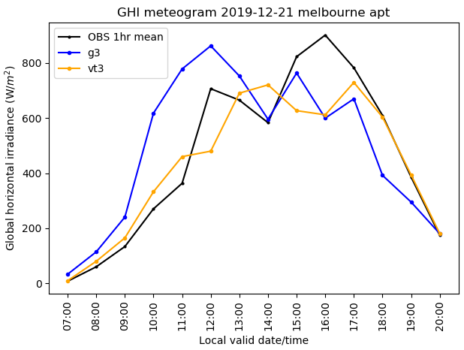
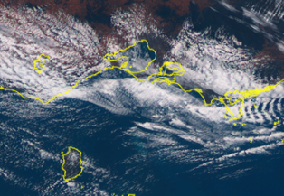
Partly cloudy over Melbourne Airport
Model | GHI Bias | GHI RMSE
G3 | 30 | 190
VT3 | -27 | 123
Cloud is the major difficulty in forecasting solar irradiance!

Slide 6
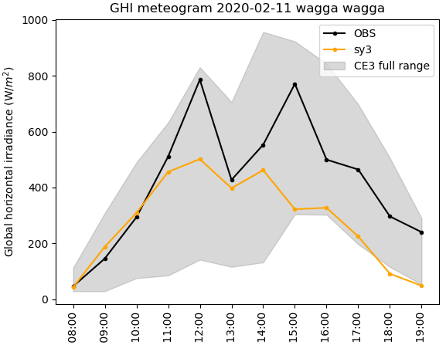
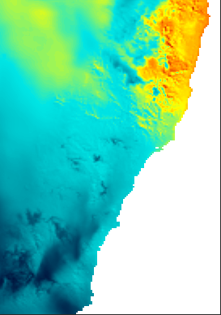
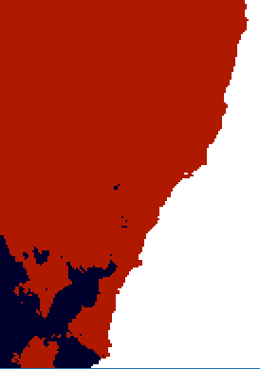
What Next?
Basics - a characterisation of ACCESS performance: "where are we at?"
ECMWF?
Role of ensemble NWP
Spatial verification techniques?
Better understand industry needs: "where do we need to get to"
e.g. 'ramping' events.
Threshold < 200Wm⁻²
chris.bridge@bom.gov.au

